Slide 1
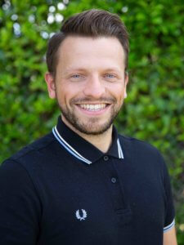
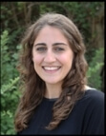
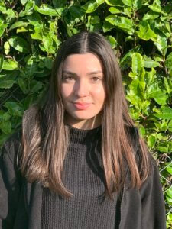
ST MICHAEL AT BOWES
Meet the Teacher 2023 and SECONDARY TRANSFER
6B: Mr Hunt
6O: Miss Iesini
6W: Miss Karakas
Miss VelAnantham

Slide 2
Secondary transfer information
We will start with sharing some information about secondary transfer and there will be time for questions at the end.
We will begin with a message from Beth Thomas from St Thomas Moore secondary school.

Slide 3
Types of Schools
Community – the Local Authority (elected Councillors) is responsible for deciding the admission arrangements for pupils
Foundation – the School’s Governing Body is responsible for deciding the admission arrangements for pupils
Voluntary Aided - the School’s Governing Body is responsible for deciding the admission arrangements for pupils
Academy and Free schools – publicly funded state schools. The Academy Council or School Governors are responsible for deciding the admission arrangements

Slide 4
Schools in Enfield
AIM North London
Aylward Academy (A)
Laurel Park School (F)
Edmonton County (A)
Enfield Grammar (A)
Highlands (C)
Lea Valley High School (A)
Oasis Academy Hadley (A)
St Ignatius RC College (VA )
The Latymer (VA/S)
Wren Academy, Enfield (A)
ARK John Keats (A)
Bishop Stopford’s CE (VA)
Chace Community (C)
Enfield County School for Girls(C)
Heron Hall Academy (A)
Kingsmead (A)
Oasis Academy Enfield (A)
St Anne’s RC ( VA )
Southgate ( A )
Winchmore ( C )

Slide 5
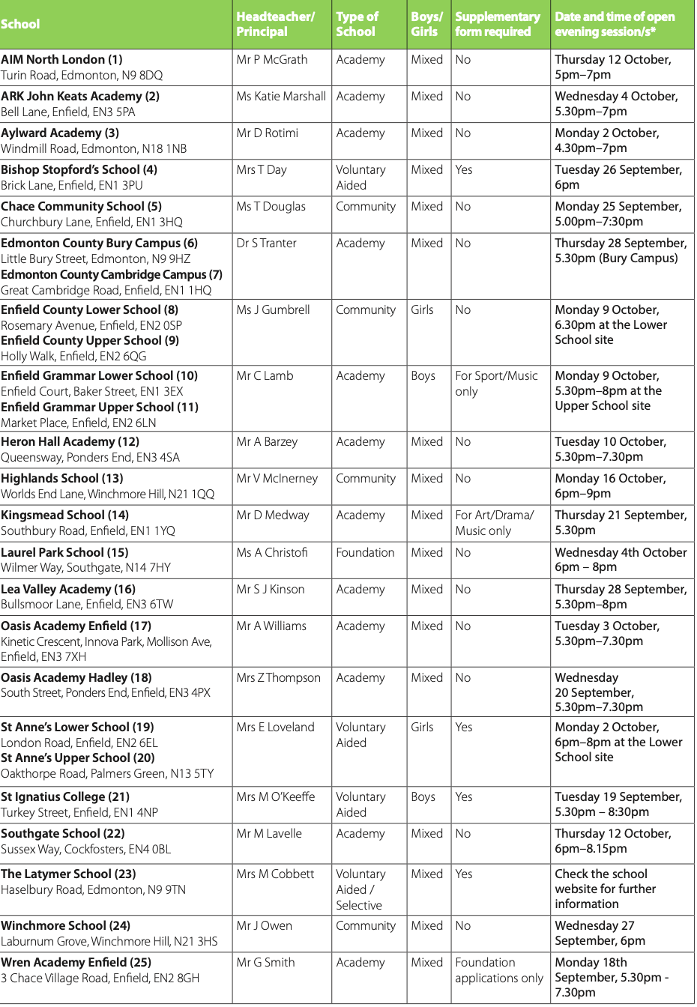
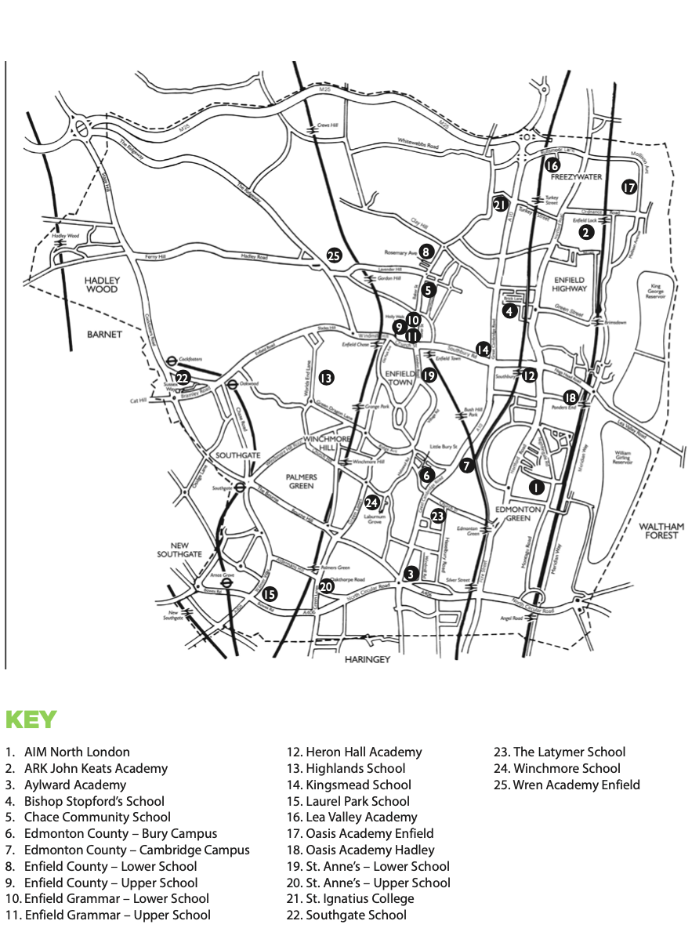
Information Booklet- page 4

Slide 6
ADMISSION CRITERIA
Rules used to decide which children are offered places when there are more applications than places available
Rules may differ between local authorities and types of schools
Check school and LA websites in case there are any changes to the information given in LA booklets

Slide 7
COMMUNITY SCHOOL ADMISSION CRITERIA
(Summary see booklet for full details)
Children in public care or previously adopted
children for whom a particular school is appropriate on genuine medical grounds
Children with a brother or sister attending the school at the time of admission (living at the same address)
Children of members of staff
Children living nearest to the school measured as the ‘crow flies’

Slide 8
Exceptions
Chace Community School has priority zones for nominated roads
Enfield County has a quota system of allocation (Full details are given in the “Your Guide to Secondary Schools in Enfield” brochure, available online).

Slide 9
Partially or Fully selective schools
Selective schools will be testing children before the closing date for applications
Children need to be registered directly with the schools to be entered for the relevant selective test/trials/auditions
Schools will let parents have the results of the test/trials/auditions before the closing date for the Borough application form

Slide 10
Partially or Fully selective schools
If results are not available before 31st October closing date, you will still need to include the school in your application
If, after receiving information about the outcome of the test, you want to change your preferred schools, you should make this request as soon as possible and no later than 8th November.
Further details on Enfield’s website

Slide 11
WHAT CAN ENFIELD PARENTS EXPECT ?
One LA application form to be used for all maintained schools regardless of LA
Common closing date for the submission of forms – 31st October 2023

Slide 12
What can Enfield parents expect?
6 preferences of secondary schools (only 4 for Hertfordshire)
equal consideration given to each school asked for
Enfield will apply on your behalf for schools outside the Borough
late applications or changes of preference will only be accepted after closing date in exceptional circumstances

Slide 13
What can Enfield parents expect?
If your child is eligible for more than one school, the preference order will be used to decide the final offer
single offer emailed to parents/carers – 1st March 2024

Slide 14
How to apply www.edmissions.org.uk Open from the 1st September

Slide 15
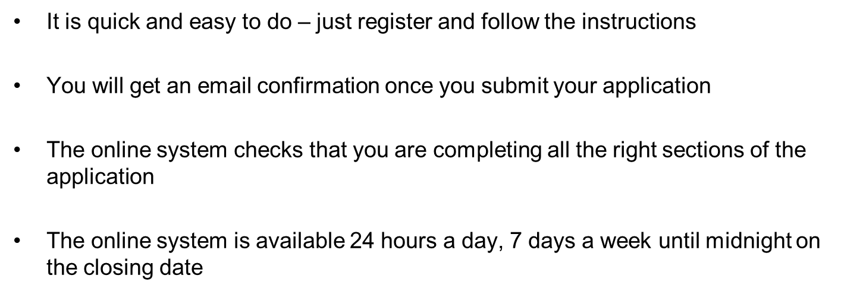
Online applications
You can get your result on the evening of 1st March 2024 and either accept and decline your offer on line

Slide 16
CHECKLIST
Before you fill in the form
Visit schools you are interested in, especially those in the local area
Distance counts for many schools and will be a deciding factor
Outside Enfield get the relevant information booklet or check their website
Check you may need to complete a supplementary information form and send them directly to the school
Complete all forms in full
Be sure the address you use is the child’s usual place of residence. Attach details if not
Ensure you include your council tax reference number in your application.
Nominating only one school or the same school six times will not improve your chance of getting a place.
Be realistic
Good Luck!

Slide 17
Making your application
Make sure you say …
If the child is looked
after or adopted?
Are there brothers or sisters attending any of the schools you apply for?
Does a parent work at any of the schools listed on your form?
Provide supporting information with your application if you are asking for medical priority
Be sure the address you use is the child’s usual place of residence. Attach details if not
Ensure you include your council tax reference number in your application.
Complete any supplementary forms and send them directly to the schools
Meet all the deadlines

Slide 18
Enfield Schools - What happened this year
The furthest distance the LA offered places for
admission in September 2021 on offer day
(1st March 2020).
ARK John Keats - 0.308 miles
Aylward -1.235 miles
Edmonton County - 1.145 miles
Heron Hall – 2.452 miles
Highlands - 0.966 miles
Kingsmead - 0.916 miles
Southgate – 2.647 miles
Winchmore – 1.001 miles

Slide 19
SECONDARY TRANSFER for SMAB PUPILS academic year SEPTEMBER 2022
5 | Aylward Academy
1 | Ashmole
0 | Alexandra Park
21 | Broomfield
0 | Chace Community
0 | East Barnet
0 | Edmonton County
1 | Enfield County
1 | Heron Hall
3 | Heartlands
1 | Highlands
2 | St Andrew The Apostle
2 | Greig City Academy
8 | St Thomas More
1 | Bishop Douglas
4 | Southgate
1 | St Ignatius
3 | Winchmore Hill
23 | Mulberry Woodside High
2 | Wren Academy
1 | Skinners academy
1 | Gladesmore
1 | Dukes Academy
2 | Compton

Slide 20
Things to remember:

Slide 21
Things to remember

Slide 22
Things to remember

Slide 23
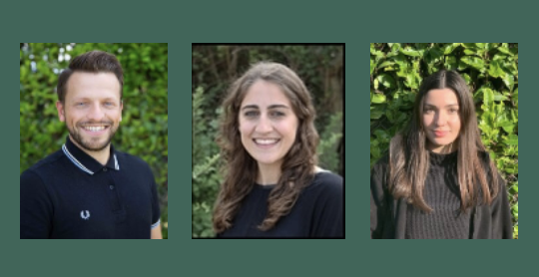
Meet the teacher
We will now move on to sharing some information about Year 6

Slide 24
Year 6
Punctuality – 8:40am gates open and 8:45am start in class. 3:20pm end of the day.
Correct uniform – studs, no hoops. Hairbands should be green/white/black.
SATs information – we will send out further information later in the year.
Information about curriculum and dates for your diary have been shared in our curriculum letter.

Slide 25
PE
On PE days, please ensure your child is wearing full PE kit – SMaB logo t-shirt, green joggers or shorts and trainers. No cycling shorts.
All of year 6: Mondays and Fridays

Slide 26
Reading
Daily reading is an essential part of their learning – it enhances their creative thinking and writing skills.
We encourage 20 mins of reading a day. Setting a regular time works best.
Reading should be a pleasurable experience.
This could be them reading, an adult reading to them and it could be in English or another language.
Please continue to use reading records to record what your child has read. You can use the reading record sheet to help children to complete themselves. Reading records will be collected on Mondays.

Slide 27
Home Learning
We have sent home a home learning grid
Home learning is due on a Wednesday – please send photos on Microsoft Teams or bring in home learning books.
Spellings will be taught and tested regularly in school.

Slide 28
SATs packs
Your child has received a SATs pack
This includes 2 revision guides and 6 workbooks
Each week there will be home learning from these books which we will go through together in class
This is the ideal opportunity for teachers to pick up on and address misconceptions and identify key areas to work on

Slide 29
Year 6 support materials
Times Table Rockstar Programme: to make a success of this programme and ensure that your child follows the programme of practising and remains motivated we need your help. It is recommended that your child practices their times tables everyday.
Letter Join – we use this handwriting scheme. You can login on
www.letterjoin.co.uk username: vt0869
password: home
There are also lots of resources online that can support your children, for example, BBC Bitesize, Top Marks and White Rose.

Slide 30
Dojo
Classes will continue to use Class Dojo to ensure communication between school and parents. Our weekly newsletter is on there too!
We ask that you bear in mind, though teachers can be messaged by you at any time, they will only be able to respond back to within the hours of:
Monday – Friday 7:30am – 5:30pm
If you have a message during school hours e.g. about pick up, please call the office, who will let Class Teachers know
You can also follow SMAB updates on our SMAB Twitter page, Instagram and YouTube!

Slide 31
QUESTIONS?

